Slide 1

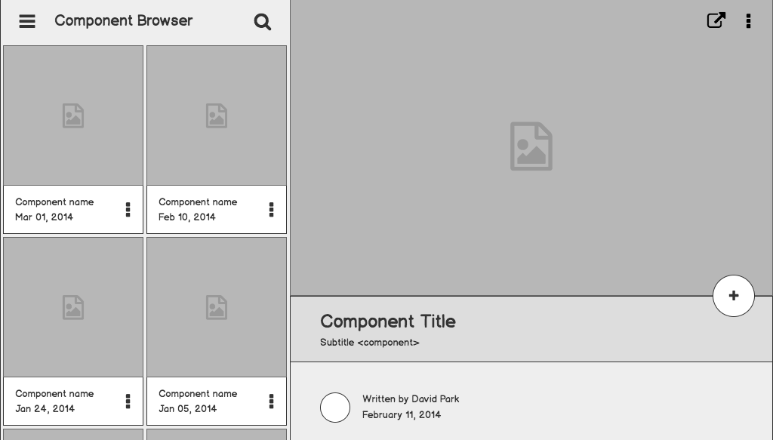

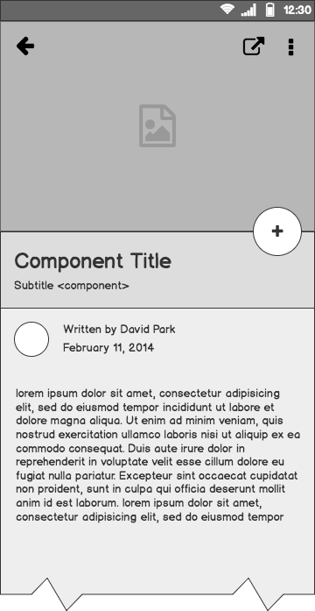
NoM

Slide 2
Outline
The Problem
Solution Proposal
Wireframes
Next Steps

Slide 3
The Problem

Slide 4
Problem statement
Unprecedented Value of Goods
Product of values,goods are stimulated, controlled by people who doesnt under estimate.
Broken Supply chain
Supply chain is broken due to unimaginable intercepts and Mediators.

Slide 5
What customers do today
Producer status
People are constantly producing and selling their goods
Unaware about their Level
Unnoticing thier Importance
Unnoticied about thier products final status

Slide 6
Solution Proposal

Slide 7
Solution description
To create a platform which can work
OFFLINE via command line ie message
TRANSPARENT due to Centralized Public Azure Storage
TRUE VALUE based on current supply demand, Azure ML

Slide 8
Wireframes

Slide 9
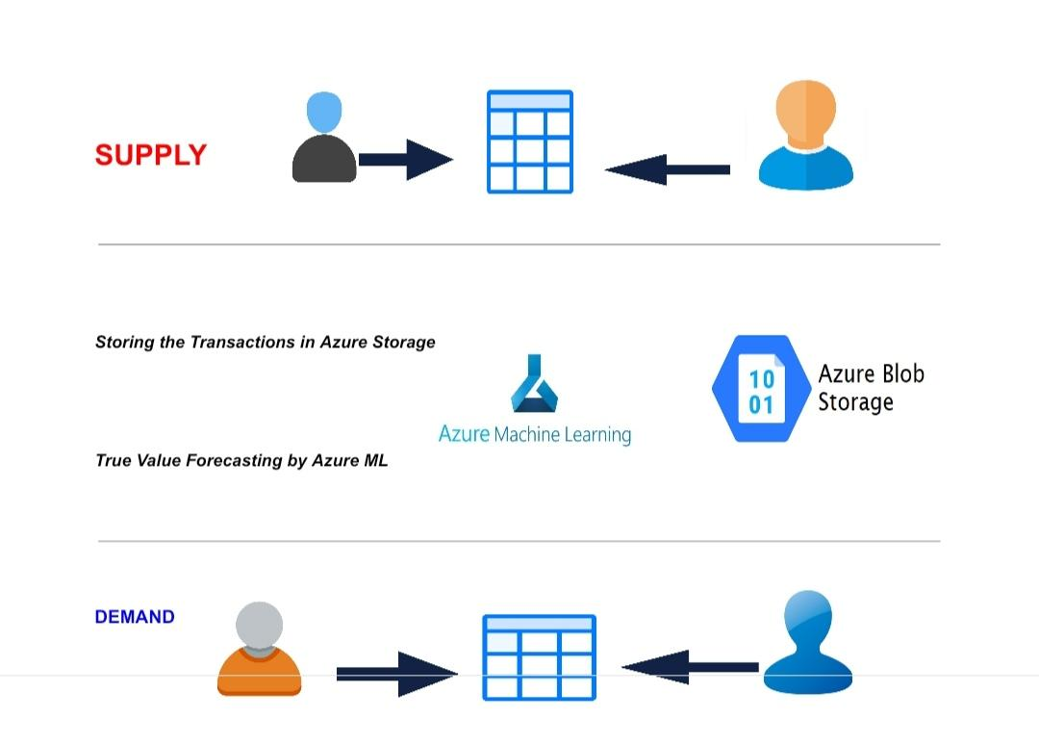
Timeline
MAY
JUN
TODAY
AUG
SEPT
OCT
NOV
Requirements gathering
User research
Wireframes
Review
Prototype
User testing
Dev hand-off

Slide 10
